Slide 1
Vector Space

Slide 2
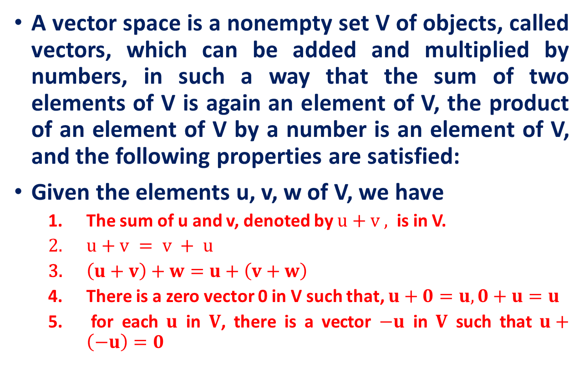
Recall: Vector space
A vector space is a nonempty set V of objects, called vectors, which can be added and multiplied by numbers, in such a way that the sum of two elements of V is again an element of V, the product of an element of V by a number is an element of V, and the following properties are satisfied:
Given the elements u, v, w of V, we have
The sum of u and v, denoted by $u+v ,$ is in V.
$u+v = v + u$
$\left(u+v\right)+w=u+\left(v+w\right)$
There is a zero vector 0 in V such that, $u+0=u, 0+u=u$
for each $u$ in $V$, there is a vector $−u$ in $V$ such that $u+\left(−u\right)=0$

Slide 3
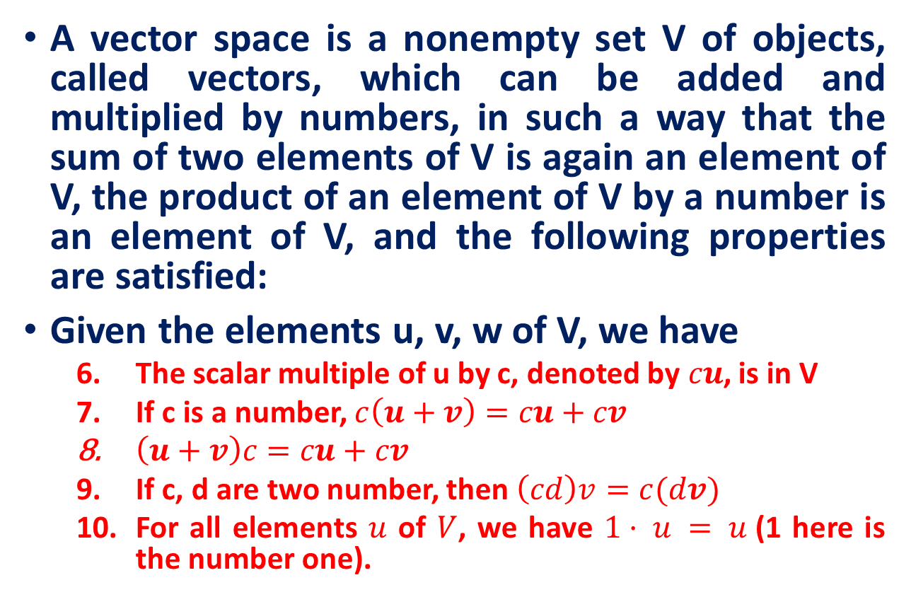
Recall: Vector space
A vector space is a nonempty set V of objects, called vectors, which can be added and multiplied by numbers, in such a way that the sum of two elements of V is again an element of V, the product of an element of V by a number is an element of V, and the following properties are satisfied:
Given the elements u, v, w of V, we have
The scalar multiple of u by c, denoted by$cu$, is in V
If c is a number, $c\left(u+v\right)=cu+cv$
$\left(u+v\right)c=cu+cv$
If c, d are two number, then $\left(cd\right)v=c(dv)$
For all elements $u$ of $V$, we have $1· u = u$(1 here is the number one).

Slide 4
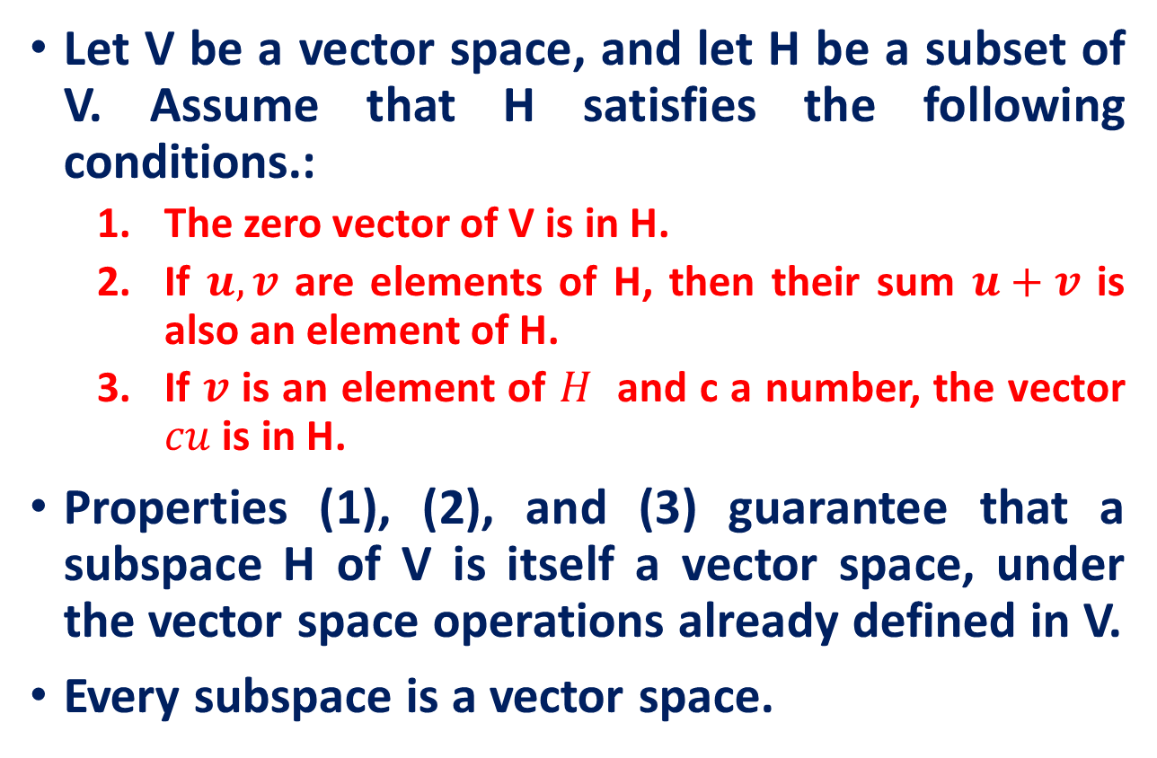
Recall: Subspaces
Let V be a vector space, and let H be a subset of V. Assume that H satisfies the following conditions.:
The zero vector of V is in H.
If $u, v$ are elements of H, then their sum $u+v$ is also an element of H.
If $v$ is an element of $H$ and c a number, the vector $cu$ is in H.
Properties (1), (2), and (3) guarantee that a subspace H of V is itself a vector space, under the vector space operations already defined in V.
Every subspace is a vector space.

Slide 5
Linear Combination
Let V be a vector space, and v₁, v₂, …, v_{n} be elements of V. Let n real number c₁, c₂, …, c_{n}, then the vector w obtained by w = c₁ v₁+ c₂ v₂+ …+ c_{n} v_{n}
is called a linear combination of v₁, v₂, …, v_{n,} and c₁, c₂, …, c_{n} are called coefficients of the linear combination.
The set of all linear combinations of v₁, v₂, …, v_{n} is a subspace of V

Slide 6
Picture
Linear combinations of two vectors u and v.
u–2v
3u
2u+0.5v
–v
u
2u+2v
0
v

Slide 7
A Subspace Spanned by a Set
The set consisting of only the zero vector in a vector space V is a subspace of V, called the zero subspace and written as {0}.
Span {v₁,…,v_{p}} denotes the set of all vectors that can be written as linear combinations of v₁,…,v_{p}.

Slide 8
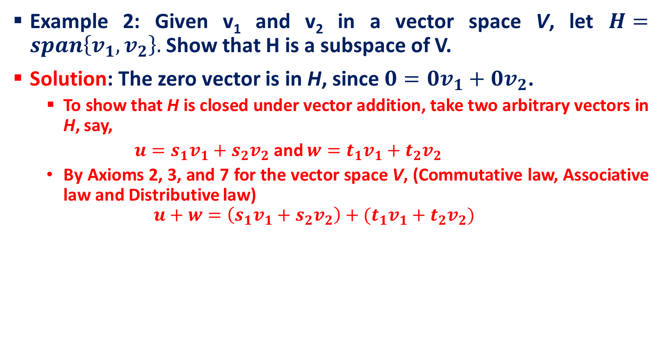
A Subspace Spanned by a Set
Example 2: Given v₁ and v₂ in a vector space V, let $H=span\left\{v_{1},v_{2}\right\}.$ Show that H is a subspace of V.
Solution: The zero vector is in H, since $0=0v_{1}+0v_{2}$.
To show that H is closed under vector addition, take two arbitrary vectors in H, say,
$u=s_{1}v_{1}+s_{2}v_{2}$ and $w=t_{1}v_{1}+t_{2}v_{2}$
By Axioms 2, 3, and 7 for the vector space V, (Commutative law, Associative law and Distributive law)
$$u+w=\left(s_{1}v_{1}+s_{2}v_{2}\right)+(t_{1}v_{1}+t_{2}v_{2})$$

Slide 9
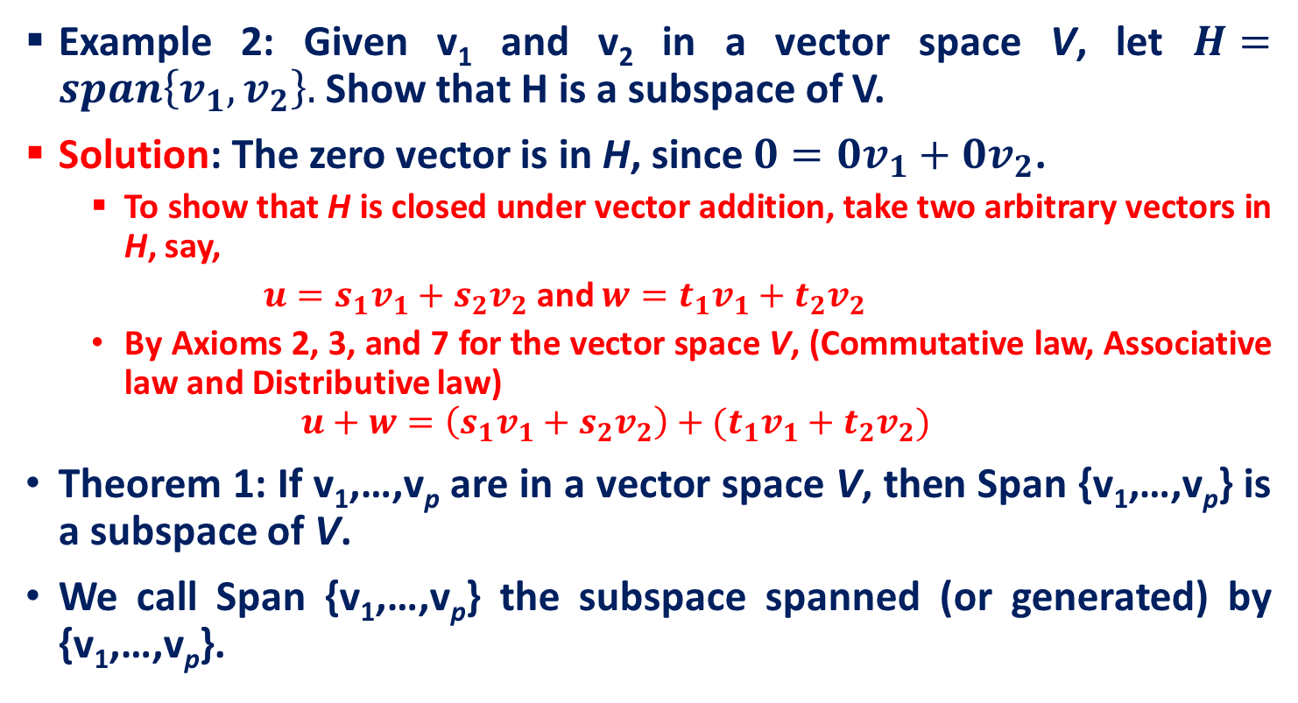
A Subspace Spanned by a Set
Example 2: Given v₁ and v₂ in a vector space V, let $H=span\left\{v_{1},v_{2}\right\}.$ Show that H is a subspace of V.
Solution: The zero vector is in H, since $0=0v_{1}+0v_{2}$.
To show that H is closed under vector addition, take two arbitrary vectors in H, say,
$u=s_{1}v_{1}+s_{2}v_{2}$ and $w=t_{1}v_{1}+t_{2}v_{2}$
By Axioms 2, 3, and 7 for the vector space V, (Commutative law, Associative law and Distributive law)
$$u+w=\left(s_{1}v_{1}+s_{2}v_{2}\right)+(t_{1}v_{1}+t_{2}v_{2})$$
Theorem 1: If v₁,…,v_{p} are in a vector space V, then Span {v₁,…,v_{p}} is a subspace of V.
We call Span {v₁,…,v_{p}} the subspace spanned (or generated) by {v₁,…,v_{p}}.

Slide 10
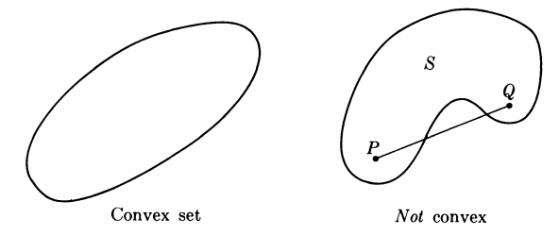
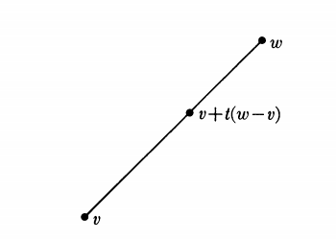
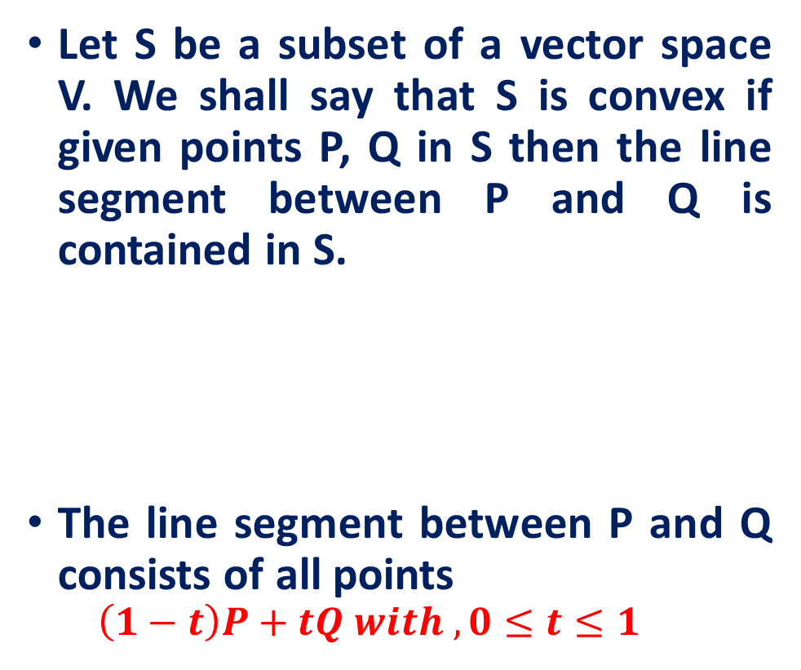
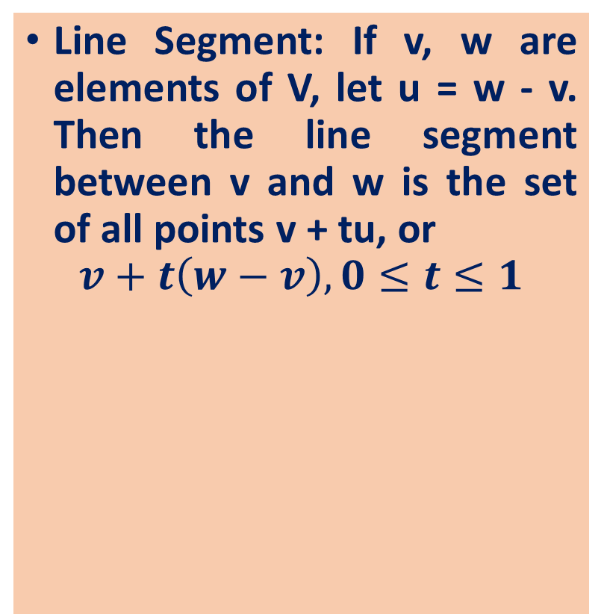
Convex Sets
Let S be a subset of a vector space V. We shall say that S is convex if given points P, Q in S then the line segment between P and Q is contained in S.
The line segment between P and Q consists of all points
$$\left(1−t\right)P+tQ with , 0≤t≤1$$
Line Segment: If v, w are elements of V, let u = w - v. Then the line segment between v and w is the set of all points v + tu, or
$$v+t\left(w−v\right), 0≤t≤1$$

Slide 11
Reference
Introduction to Linear Algebra, Mark Goldman, Emily Mackevicius
Lecture Notes on Linear Algebra, Arbind K Lal, Sukant Pati
Lecture notes on linear algebra, David Lerner
6502 : Mathematics for Engineers 2, James Burnett, Department of Mathematics, University College London
ENGG2013, Advanced Engineering Math. Kenneth Shum
Matrices and Determinants – 2, Carrer launcher
http://www.shsu.edu/ldg005/data/mth199/chapter5.ppt

